Slide 1
MUSIC AND MENTAL HEALTH
Anthony, sweta & virmar

Slide 2
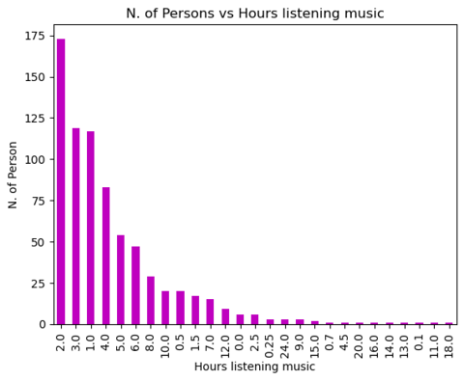
Most of the participants listen to music 1-4 hours per day.
People spend 14 hours per week listening to music on average.

Slide 3
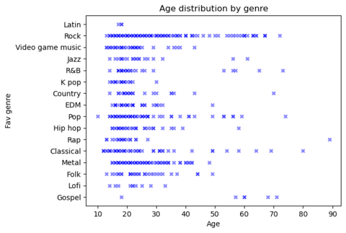
Most of the sample population who do not listen to music at all are over 40 years old.
Rock music seems to be the genre that covers most ages.
Gospel is the genre with the least amount of age concentration under 55 years old.

Slide 4
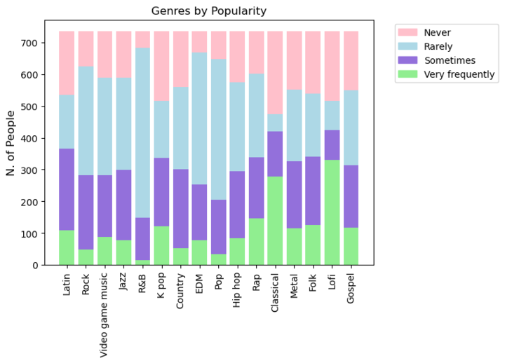
Rock is the preferred genre.
Gospel and Lofi are the least preferred genre.

Slide 5
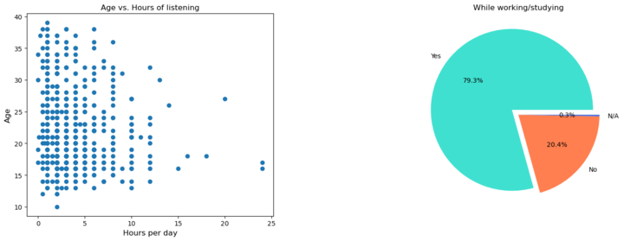
Most of the sampled population listens to music for an average of 2 to 3 hours on a daily basis.
The majority of the population do actively listen to music while working / studying.

Slide 6
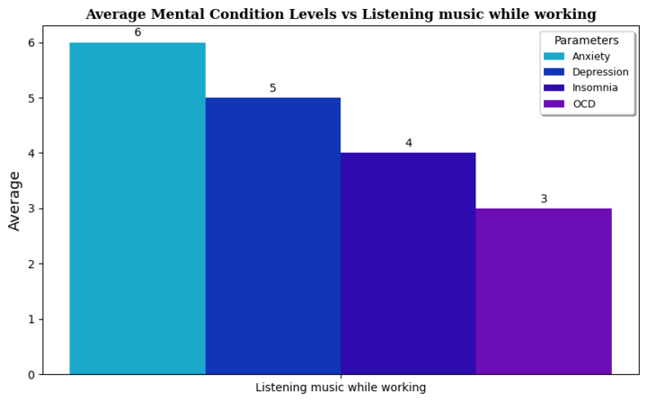
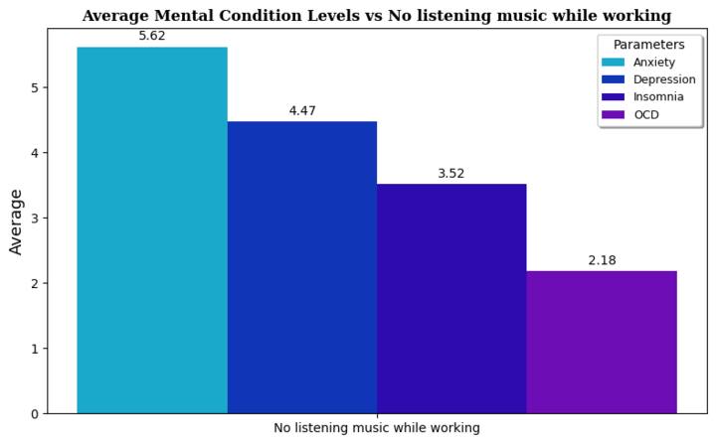
Both samples have a similar proportional levels of Anxiety, Depression, Insomnia and OCD.
However, people who do not listen to music while working have lower levels than those who do.

Slide 7
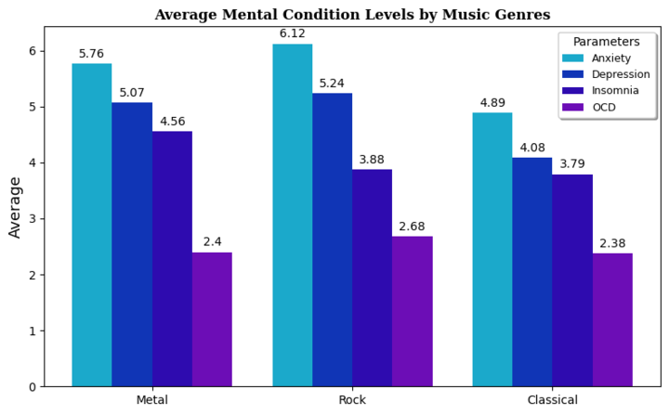
People who listen to rock and Metal music have higher anxiety, depression and insomnia levels than those who listen to classical music.
There does not seem to be a direct relation between listening to either type of music rock/metal and classical, and people who suffer from OCD.

Slide 8
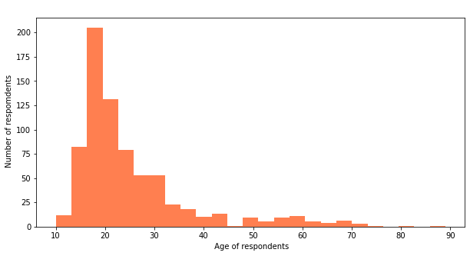

Slide 9
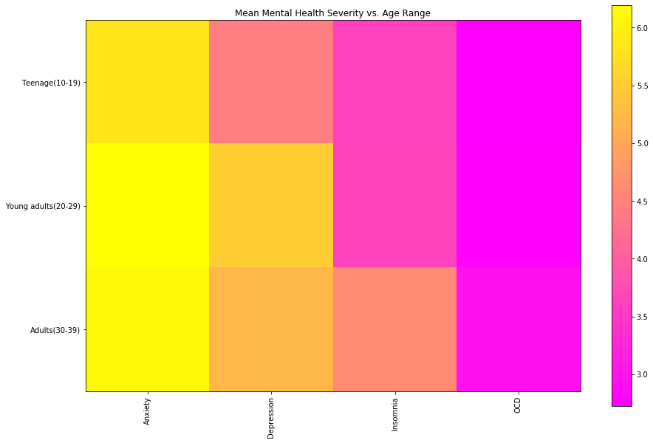
We can see high levels of anxiety and depression in older portion. Could this be related to the work and school related stress?
Follow Up: Identify how different factors are impact an individual’s self-reported level of mental health.
Notes:
We can observe from the data that the young adults and adults suffer greater levels of anxiety and depression compared to teenagers. This analysis makes sense in the context that adults may have more stressors such as work, school, billings, healthcare, etc. It makes sense for teenagers to also suffer from high levels of anxiety, but having fewer responsiblities while at school-age. For further analysis, I'd want to look at how music impacts the level of anxiety and depression while performing specific tasks. If someone listens to music while doing school work, what's their self-reported severity of mental illness during those times. Doing this could provide more insight on how music impacts these mental illnesses.

Slide 10
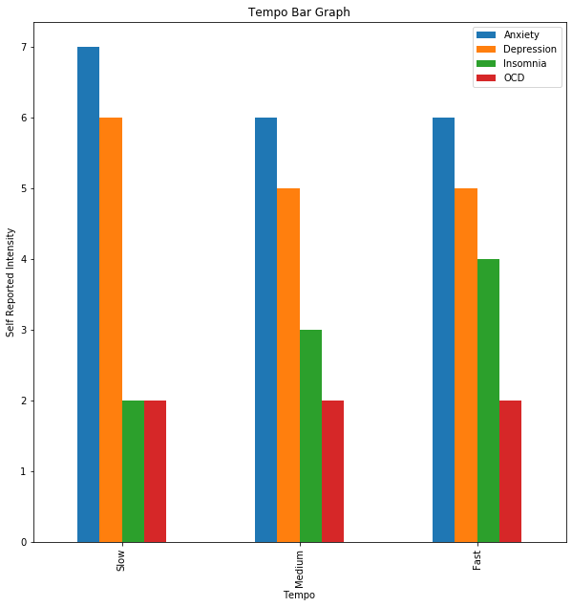
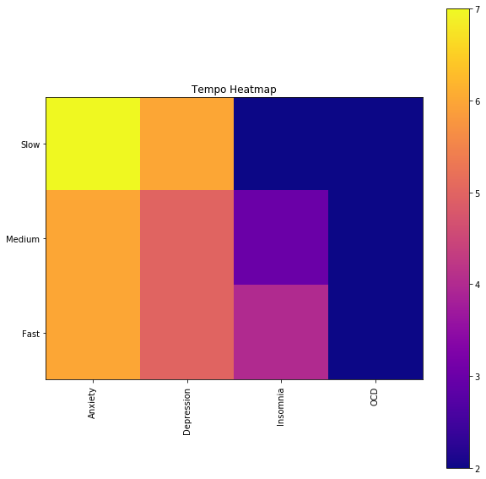
There seems to be no statistical relationship between the data.
We can infer the people in our population who reported prefer slow music have higher levels of anxiety and depression. Be weary of drawing conclusions.
Follow Up: Looking at the preferred tempo may not yield relevant information.
Notes:
We can see higher levels of anxiety and depression all at tempos, but that also reflects our analysis in the previous question. We see high levels of anxiety and depression compared to insomnia and OCD. There could be little information to be gatheedr from future analysis. However, if we want to evaluate tempo, we could look at specific favorite songs or if people have prefered songs while expereince higher levels of mental illness. From this, we could potentially see if there is a relationship between specific instances of high mental illness and music.

Slide 11
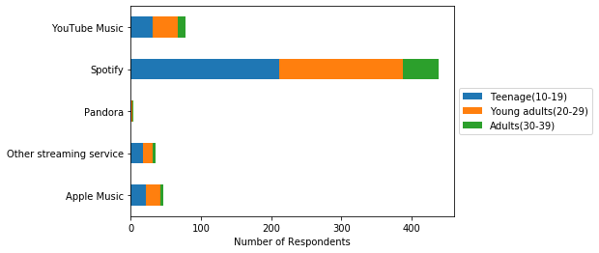
Primary streaming services by Age groupage group
Spotify is the most preferred choice across the age groups
The next best choice is YouTube
Free music is most preferred

Slide 12
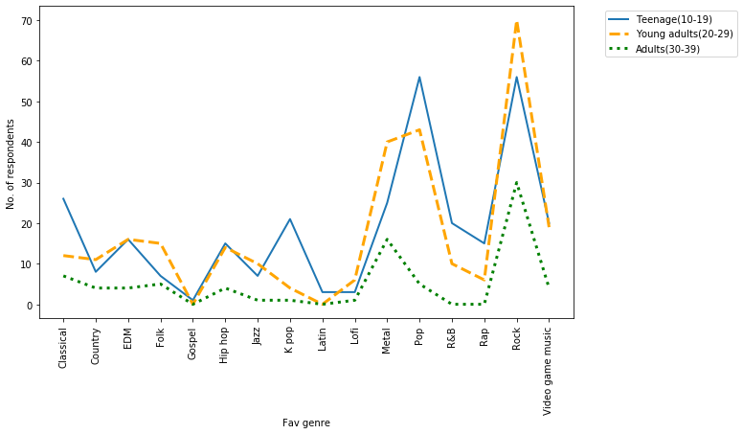
Favorite Genre by Age groupage group
Rock is ranked as top fav genre across the age groups
Pop is ranked as second favorite for teenage and young adults but adults prefer metal music
Amongst teenagers K-pop is quickly catching up along with Metal
Apart from Rock and Metal, adults have a diverse preference of music

Slide 13
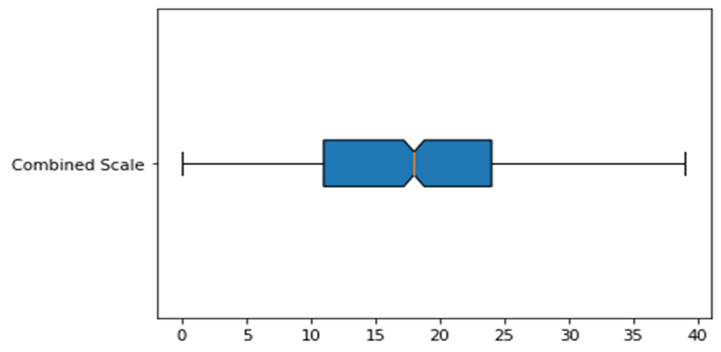
Favorite Genre by Combined Mental health scale
Four different mental health ranking were Self reported - Depression, Anxiety, OCD and Insomnia on a scale of 0-10
We combined all four mental health ranking were Self reported - Depression, Anxiety, OCD and Insomnia on a scale of 0-10
Further the combined score were classified as:
Combined scale >25 = High Mental health scale
Combined scale between 15-24 = Moderate Mental Health scale
Combined scale <15 = Low Mental Health scale

Slide 14
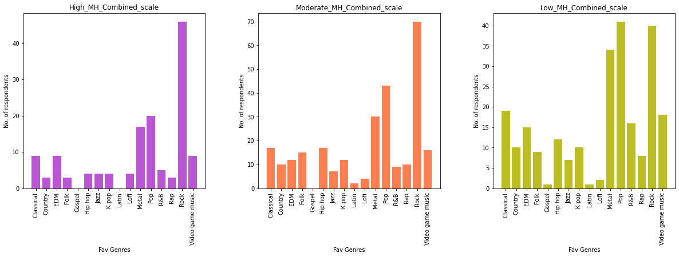
Combined Mental Health Score and genre correlation
Rock, Pop and Metal again is the top choice by this micro segments.
People who have Low mental health scale are listening to diversified range of music

Slide 15
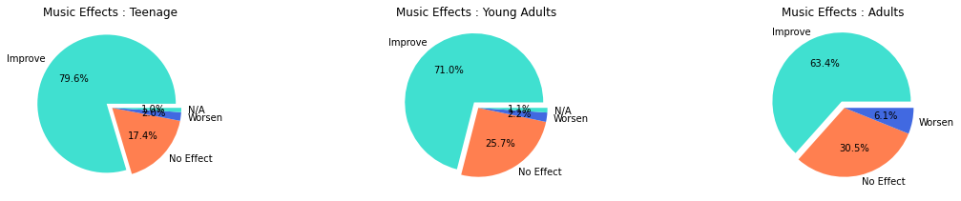
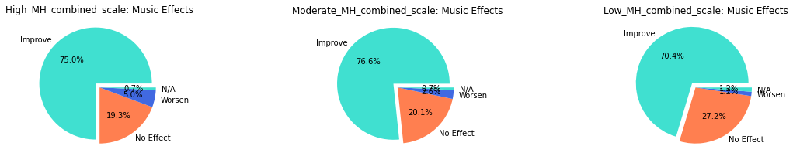
Does music improve/worsen mental health conditions ?
Based on Age group segment
Based on Combined mental health score
Music definitely helps across all segments to improve their mental health
Further more recurring data with respect to these respondents music listening behaviors and their mental health scale at that point will help us to understand which mix of genres are helpful to improve their mental health condition

